Slide 1



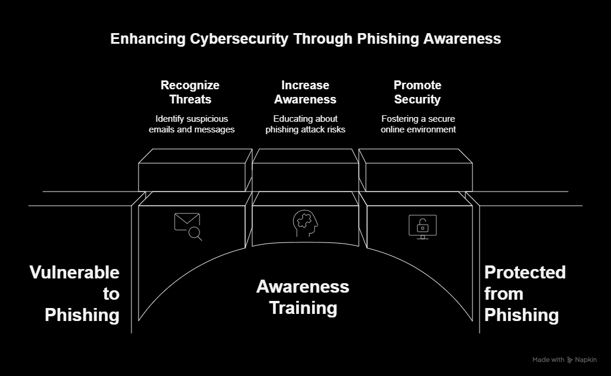



Phishing Awareness Training

Slide 2
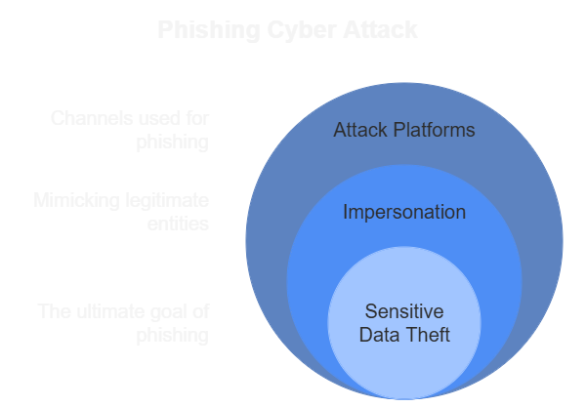
What is Phishing?
Phishing is a cyber attack where attackers impersonate legitimate entities.
The goal is to steal sensitive data like login credentials and credit card numbers.
Common platforms: Email, SMS, social media, fake websites.

Slide 3

Table of contents
Common Signs of a Phishing Email
Real-World Phishing Example
01
02
Some points about Phishing Email
Reltive Example
How to Identify Phishing
How to Protect Against Phishing
03
04
Points to have in mind
How to be secure

Slide 4
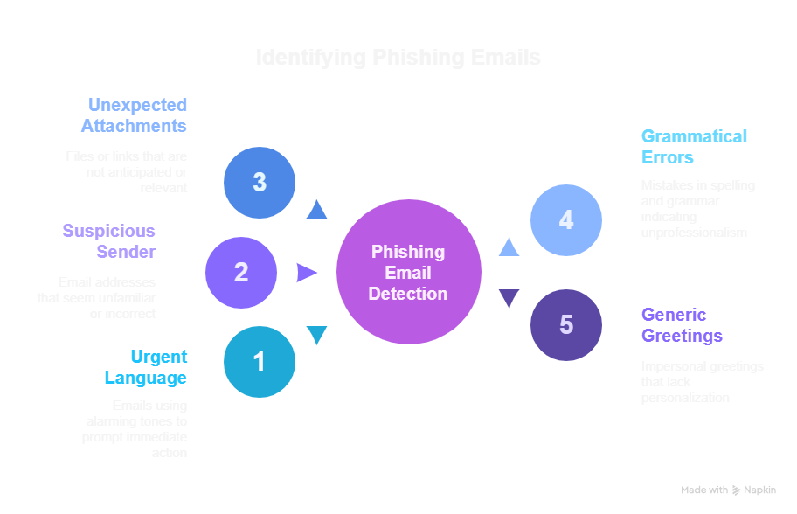
Common Signs of a Phishing Email
01

Slide 5
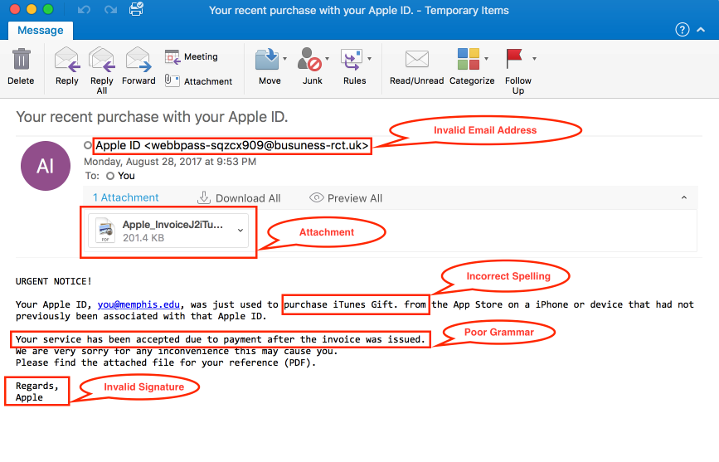
Real-World Phishing Example
02

Slide 6
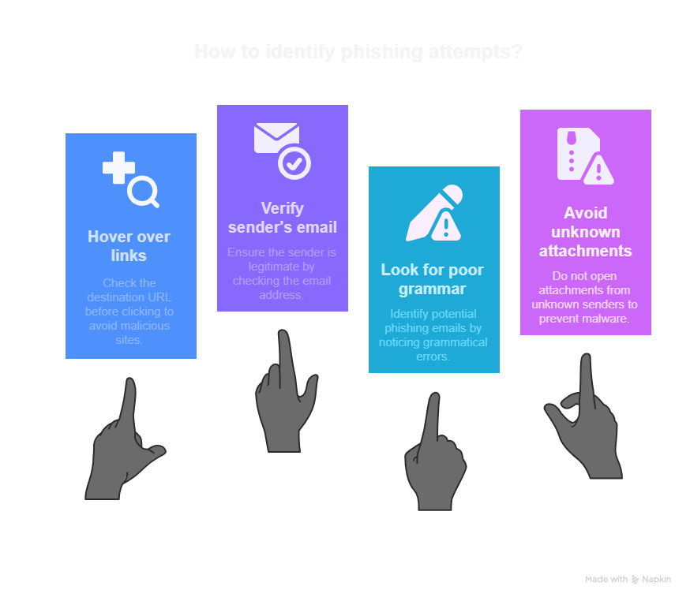
How to Identify Phishing
03

Slide 7



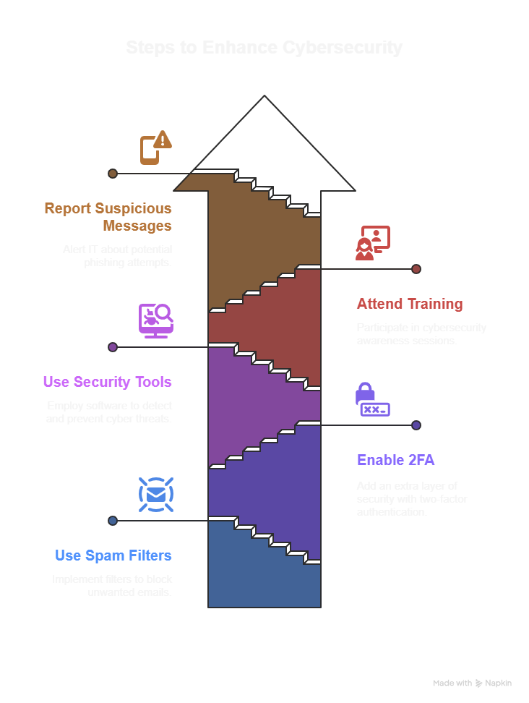
How to Protect Against Phishing
04

Slide 8
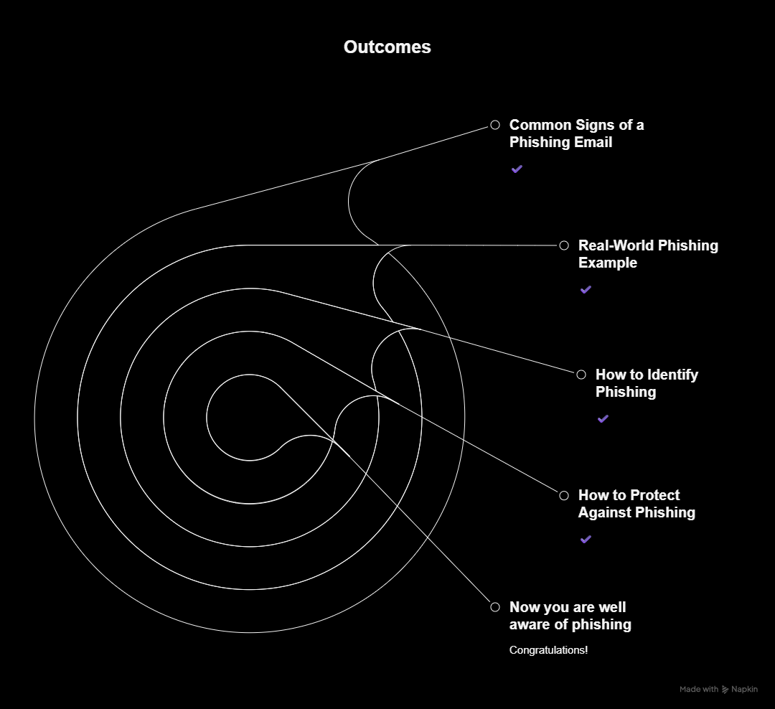
Thanks!

